Slide 1
Testing and Implementation
Individual Contribution
Kanakkahewa Y.B 204092P
Learning & Interfacing the Inductive Proximity Sensor with the microchip.
Learning about the power delivery for fast charging .
Learning about the SPI connectivity ,pins and understanding the process .
Learning how to connect the induction motor and control it.

Slide 2
Inductive Proximity Sensor (LJ18A3-8-Z/AX)
Proximity Sensors are used to detect objects (Ferrous and Non-Ferrous)
There are 3 types of proximity sensors
Inductive (Detect Metalic objects)
Capacitive (Detect objects)
IR (Read distances)
Here we use the Inductive Proximity Sensor to check the users input whether it is metal or not .
There are also two types of Inductive Proximity sensors as ,
PNP
NPN
Here we use the NPN Inductive Proximity Sensor and it has three wires to connect within .

Slide 3
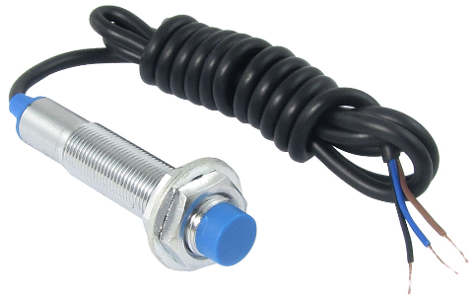
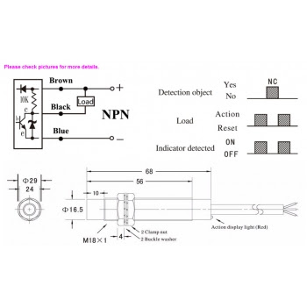
Brown- Connects to the VCC supply
Blue- Connects to the Ground
Black- Gives the output(Voltage)
Specifications: Model LJ18A3-8-Z/AX
Model : LJ18A3-8-Z/AX
Type : NPN
Power : DC12-24V(6-36V)(P-P) less than 10%
Detection distance : 8mm ± 10%
Response frequency : DC:0.5kHz AC:25Hz
Consumption current : N.P: <13mA, D: <0.8mA, A: <1.7mA
Material : ABS and Nickel plated brass
Brown(VCC)
Black(Output)
Blue(GND)

Slide 4
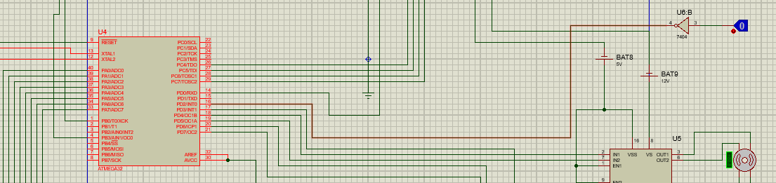
Inductive Proximity Sensor Circuit Diagram
As this sensor is not available in Proteus we decided to hardcode the relevant pin (PD2) which the sensors output pin wll be connected. Using a Logic Toggle.

Slide 5
Inductive Proximity Sensor Code
#include <avr/io.h>
#include <stdio.h>
void main()
{
DDRA= 0x80; //making PORTA_7 as output and it automatically makes PORTA_0 as input
while(1)
{
PA_0=1; // LED off, High to P1_0
if(PA_7==0)// if metal present in range
PA_0=0; //LED in ,m Low to P1_0
}
}
Data Sheet: https://www.daraz.lk/products/nickel-plated-brass-lj18a3-8-zax-npn-nc-dc-inductive-proximity-sensor-switch-detection-8mm-i108690427.html

Slide 6
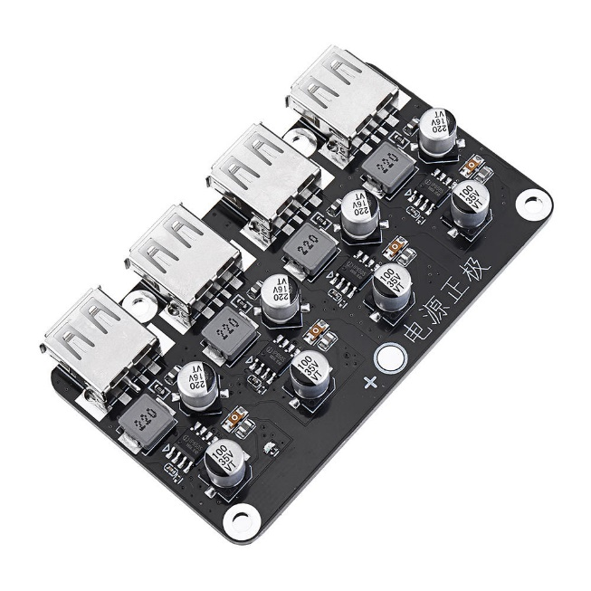
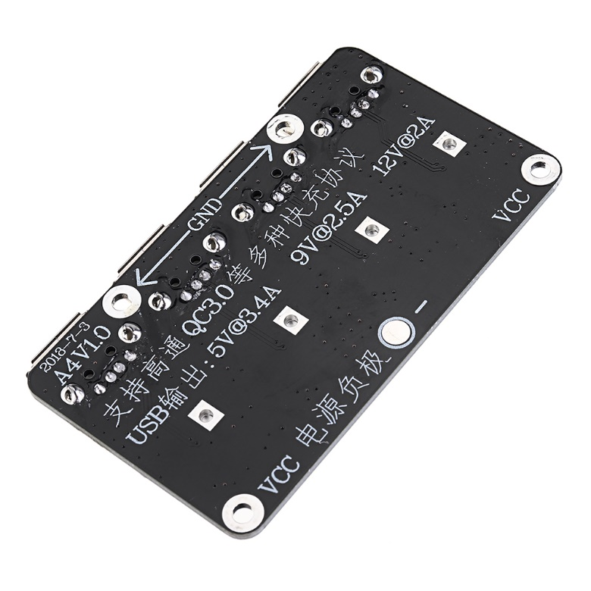
USB Fast Charging module
(SKU: 766344)
Here we have used fast charging USB ports to facilitate the fast charging .
Instead of type C we have decided to use USB type A as they are more common .
Also we have used the 1x4 channel USB fast charging module to save space and power consumption
GND
VCC

Slide 7
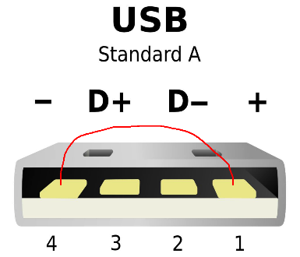
Here the D- and D+ ports inside the USB is neglected as they are for data transferring .
All we have to do is to power up the module using the supply . *Power delivery on progress.
Specifications
Power : 25V – 32V
Standby current : 0.013A
Output maximum : 24W
Switching Frequency :220 kHZ
Datasheet: https://www.banggood.com/4-USB-Fast-Charging-Module-Board-12V24V-to-QC2_0-QC3_0-Step-Down-Power-Supply-Module-12V-24V-p-1455615.html?cur_warehouse=CN

Slide 8
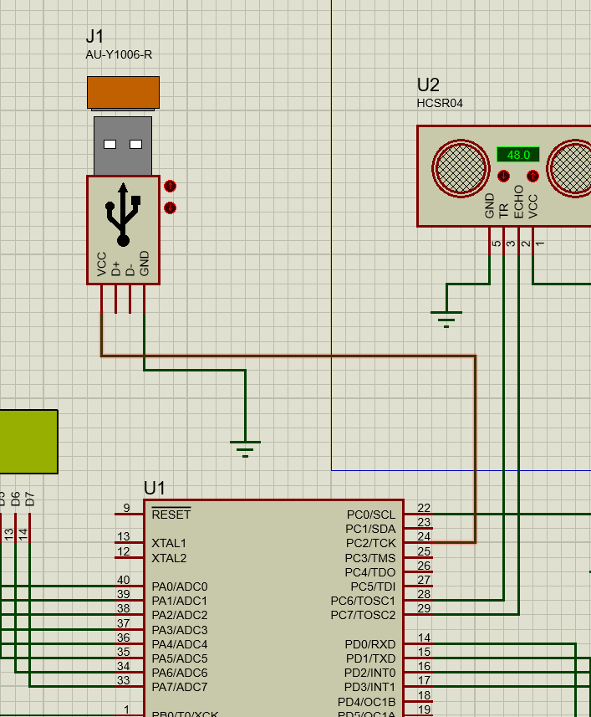

Slide 9
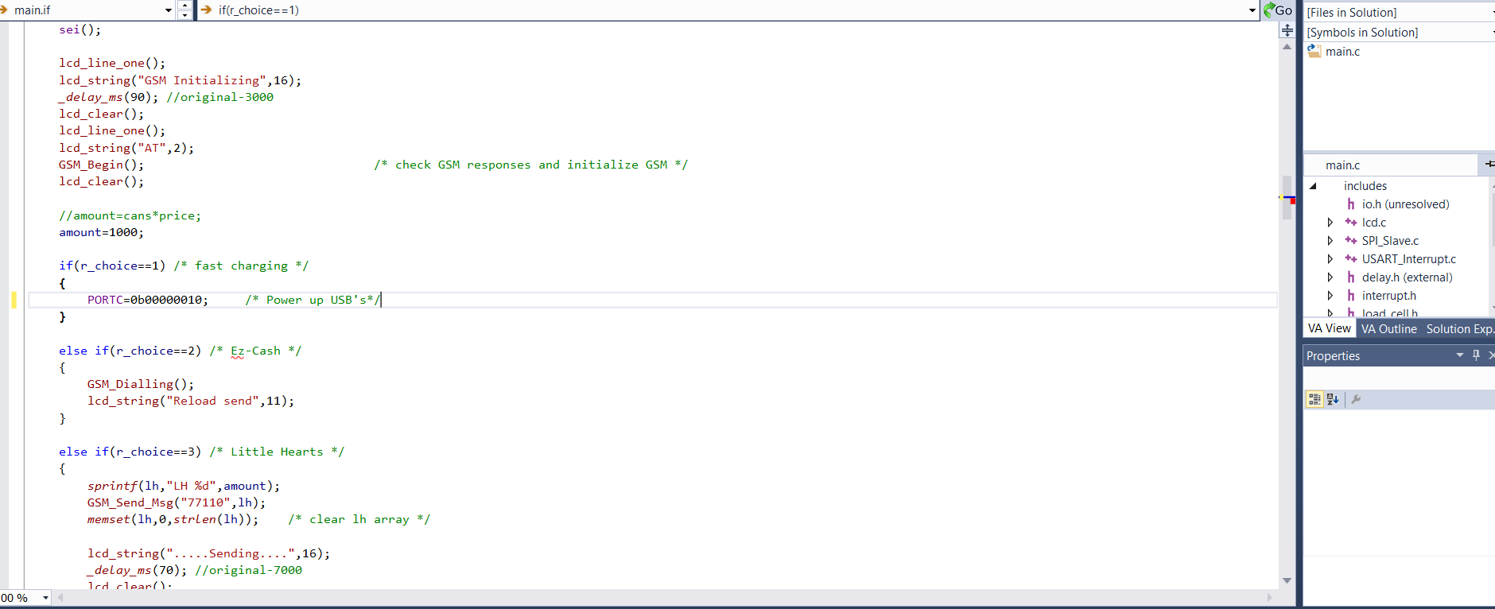

Slide 10
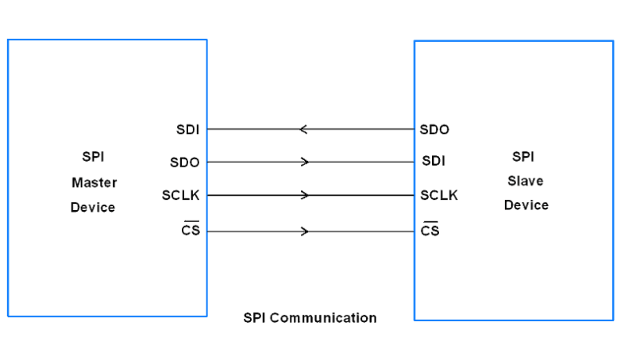
SPI(Serial Pheripheral Interface) Connectivity
Here we use a SPI communication method to communicate between the two atmega microcontrollers.

Slide 11
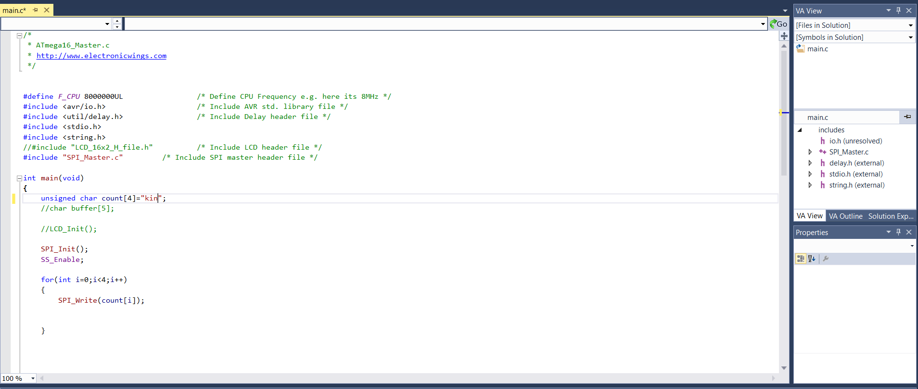
Code
This is how we tested the code before implementing to the main system. Below is the code of the master atmega.

Slide 12
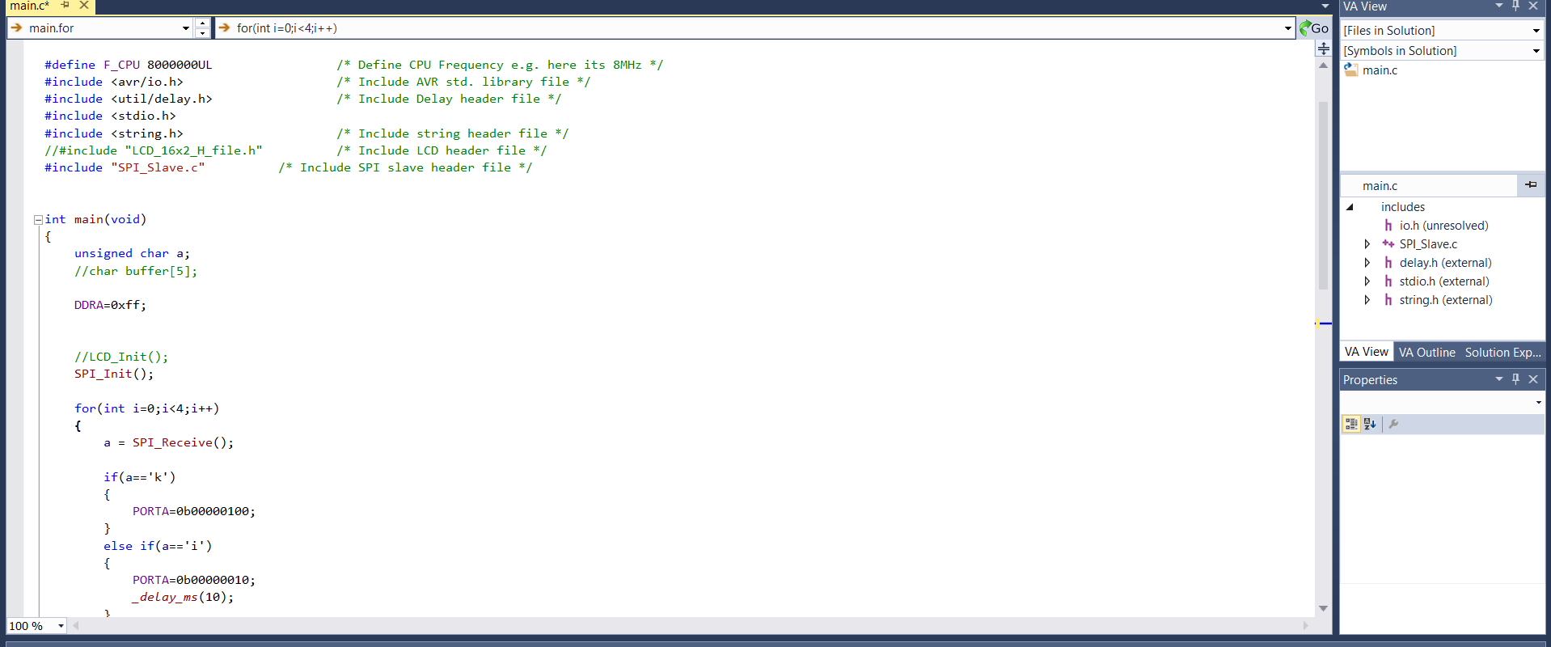
This is the code of slave atmega.

Slide 13
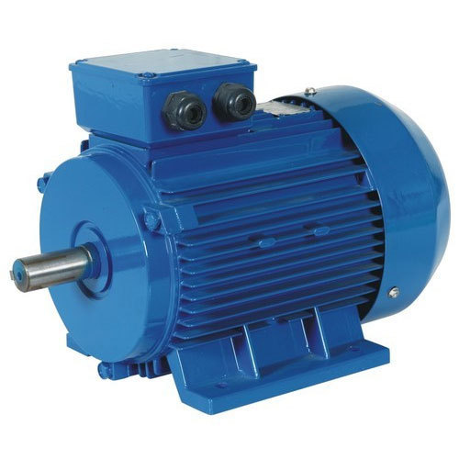
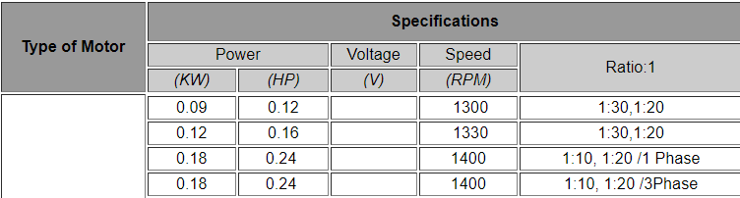
Induction Motor
(3 phase)
We use an Induction motor to crush the cans.
In order to crush the can the HP should be at least 0.1 .

Slide 14
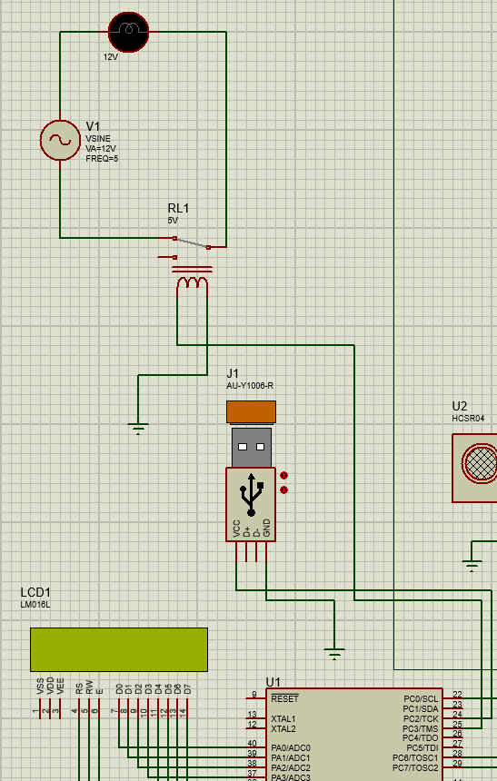

Slide 15
